Slide 1

NO2 Prediction by using Machine Learning Regression Analyses in Google EE
Anna Pavlenko July 1, 2020

Slide 2
Tech Requirements: CONNECTION TO INTERNET
Google Earth Engine:
Network
Satellite
Link

Slide 3
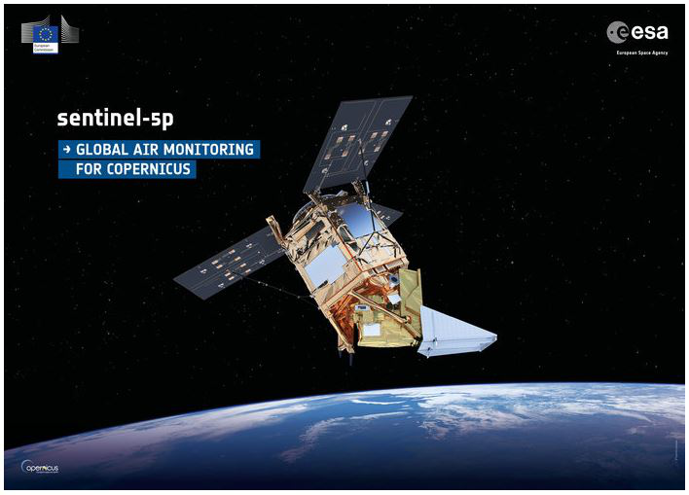
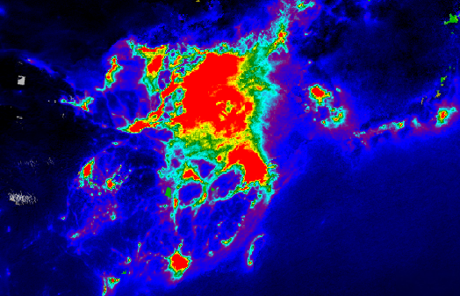
Nitrogen Dioxide (NO2) air pollution
TROPOMI instrument:
October 13, 2017
High spectral resolution: (7x3.5 km2)

Slide 4
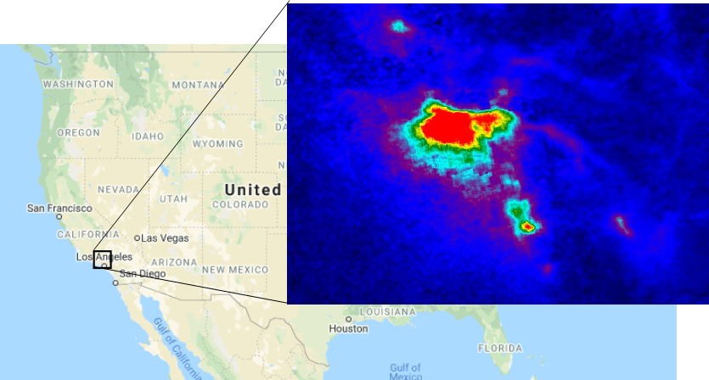
Study Area: Los Angeles, US
Data:
Sentinel-5P
TROPOMI
2018 – now
Landsat 4-8
1978 - now

Slide 5
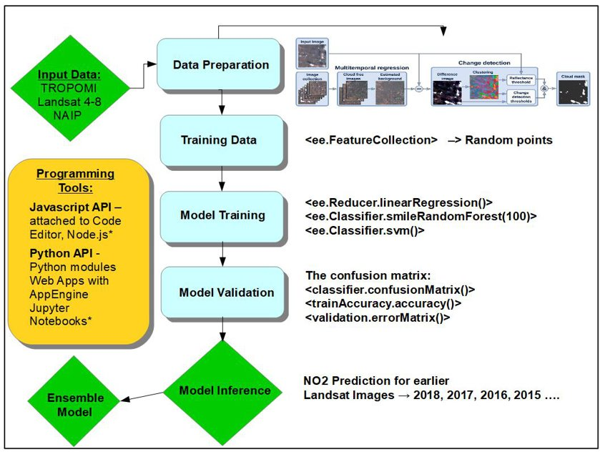
WORKFLOW

Slide 6
Regression workFlow:WorkflowWorkflow
var training = image.sample(region, scale)
var classifier = ee.Classifier.randomForest().train(training)
var result = image.classify(classifier)
var predictor = classifier.setOutputMode(Regression)
var confusionMatrix = classifier.confusionMatrix()
var accuracy = confusionMatrix.accuracy()

Slide 7
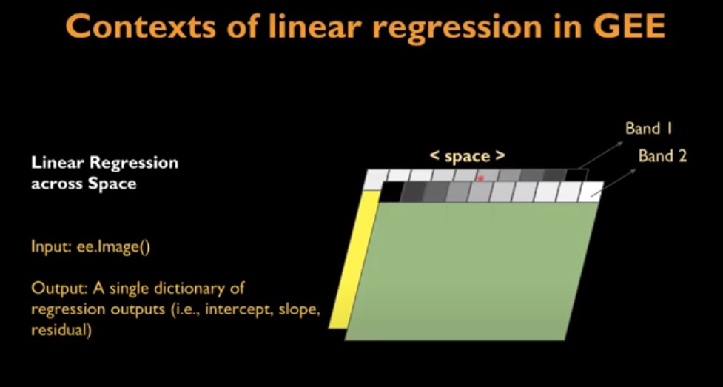
Random Forest REGRESSION: I. across space
// PREDICTION FOR 2018 YEAR:
var predict_2018 = landsat8_2018.select(bands).classify(predictor_all_data);
// NDVI_2018
var ndvi_2018 = landsat8_2018.normalizedDifference(['B5', 'B4']);

Slide 8
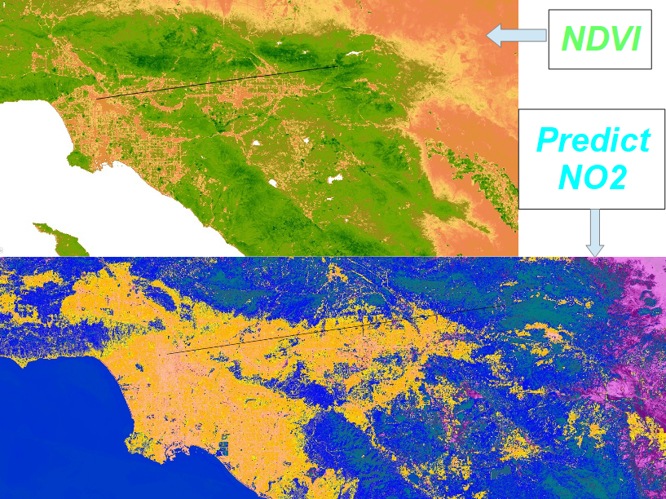
Predicted NO2 2018 & NDVI 2018

Slide 9
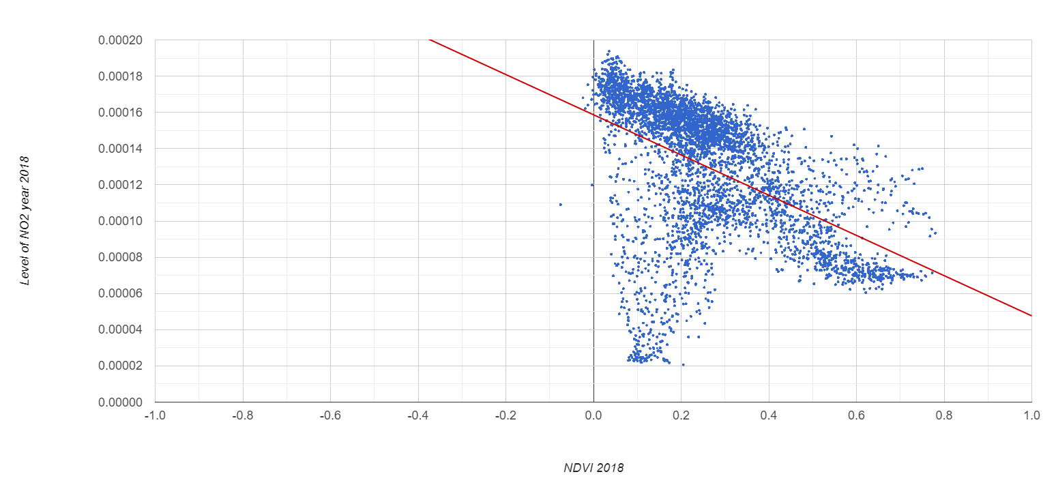
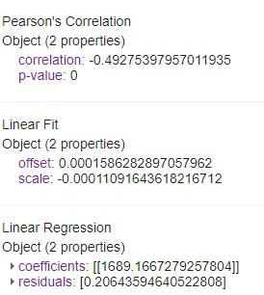
Prediction 2018

Slide 10
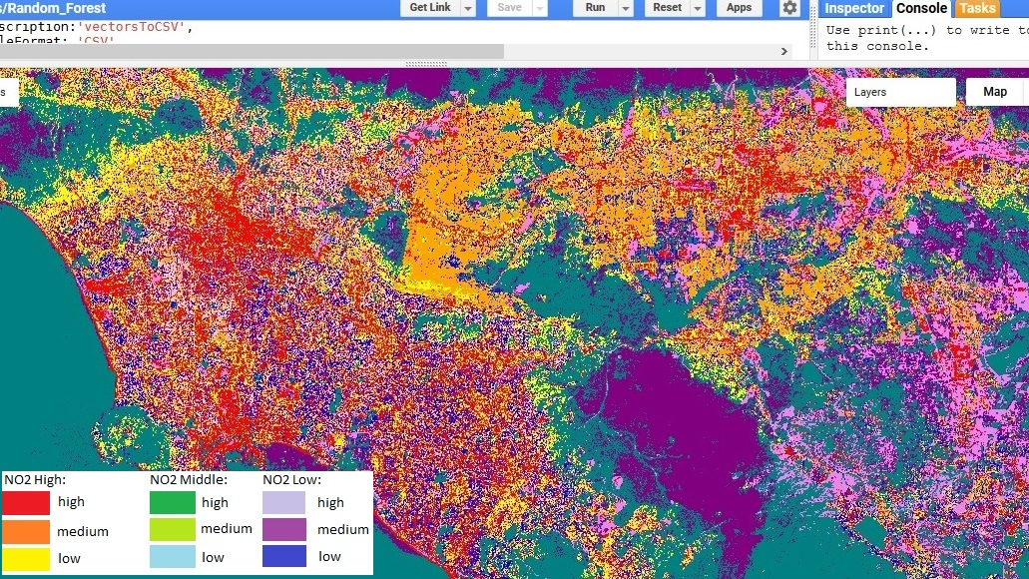
NO2 Prediction 2018

Slide 11
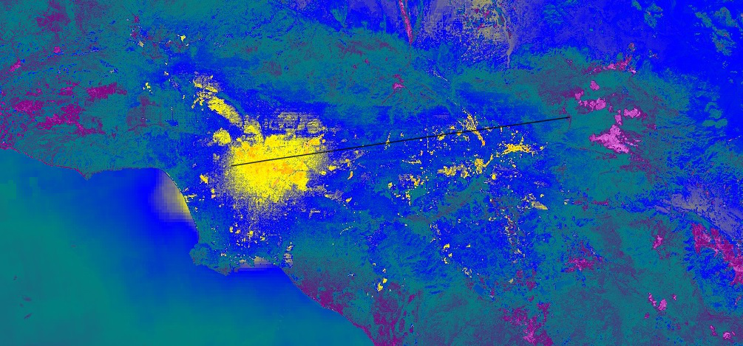
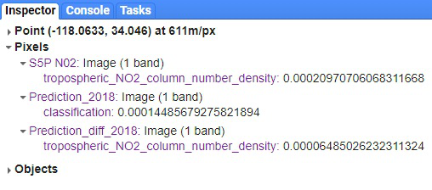
Model accuracy:

Slide 12
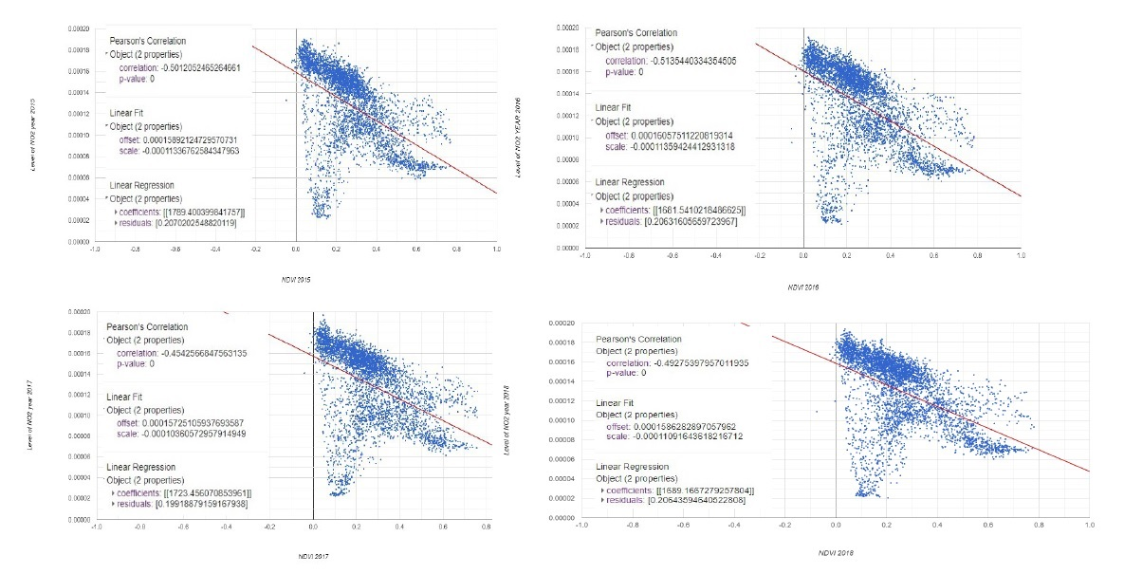
Prediction 2018 - 2015

Slide 13
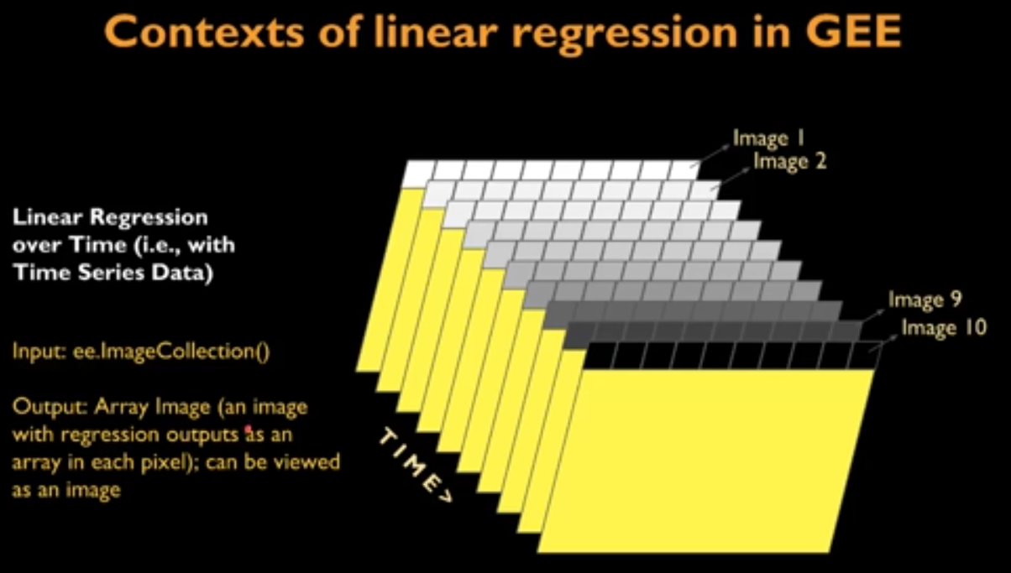
Random Forest REGRESSION: Ii. across time
NO2 PREDICTIONS for 2014 - 2018 years:
// Landsat 2018:
var predict_2018 = landsat8_2018.select(bands).classify(predictor_all_data);
var predict_2017 = landsat8_2017.select(bands).classify(predictor_all_data);
var predict_2016 = landsat8_2016.select(bands).classify(predictor_all_data);
var predict_2015 = landsat8_2015.select(bands).classify(predictor_all_data);
var predict_2014 = landsat8_2014.select(bands).classify(predictor_all_data);

Slide 14
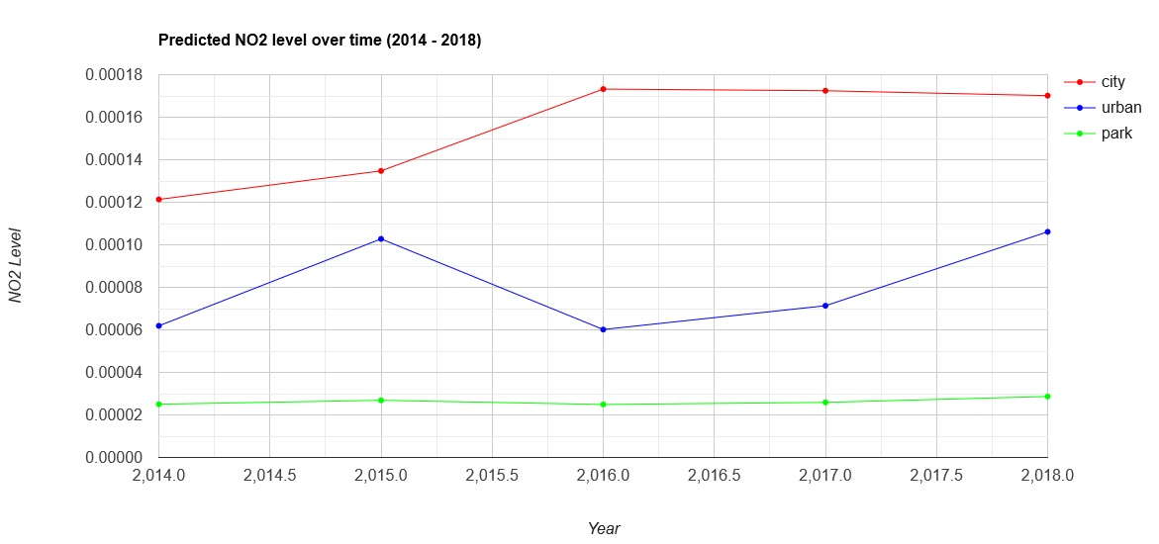
Prediction over time

Slide 15
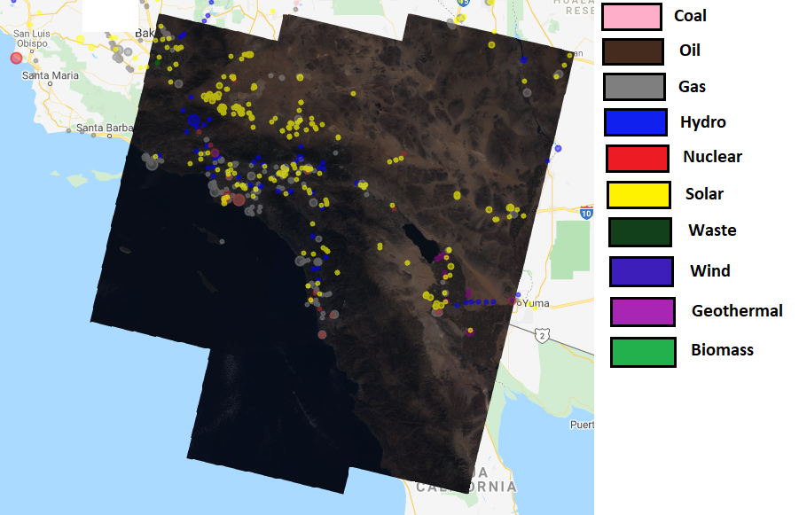
Time series 2018 – 2014 specific power plants locations

Slide 16
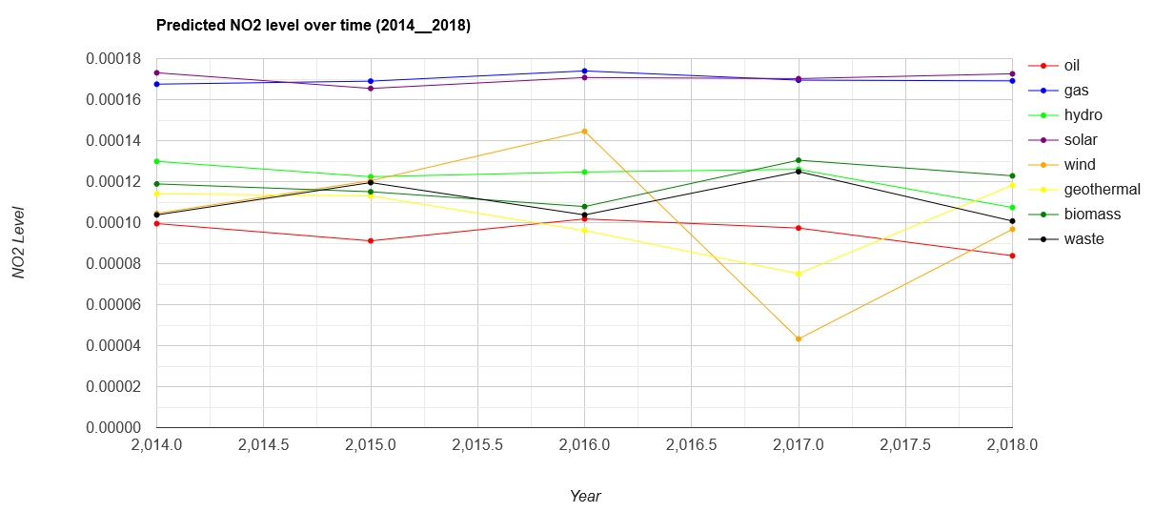
Prediction - Power plants

Slide 17
Prediction - Power plants

Slide 18

Development:
Multiple Predictions several times / the same Algorithm
Multiple Machine Learning Algorithm (SVM, Decision Tree, Random Forest)
Ensemble Model

Slide 19

Thank You
pavlenkoanna@gmail.com

